Slide 1
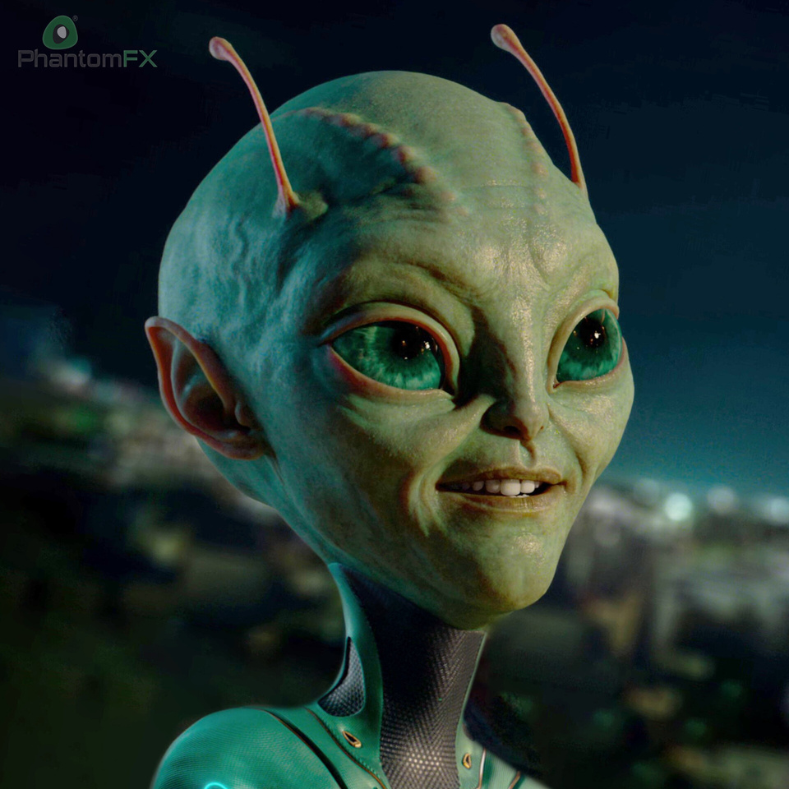
The book That Saved The Earth
~ADENGAPPA 7 PERU

Slide 2
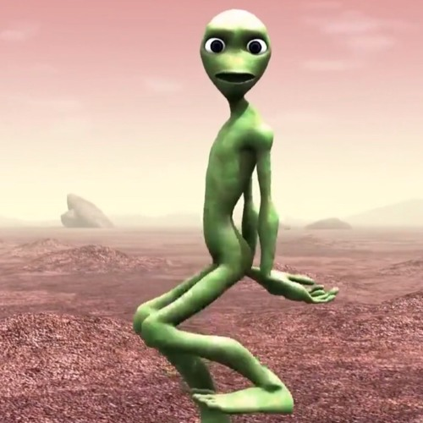


Introduction
Written by: Claire Boiko
Genre: One-act play (science fiction + comedy)
Theme: Books, imagination, and the power of literature
Setting: 25th century, Mars & Earth
Message: Never underestimate the value of books and knowledge

Slide 3
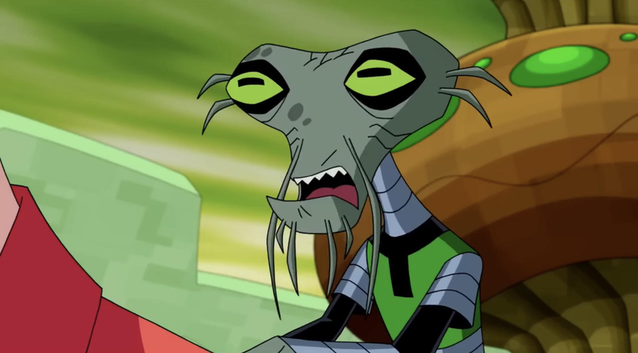
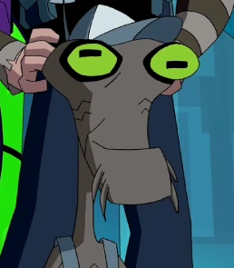
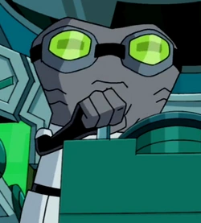
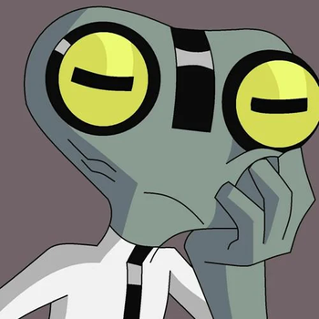
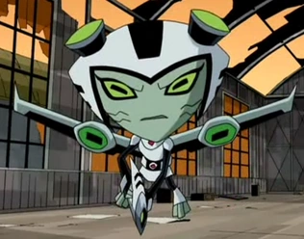
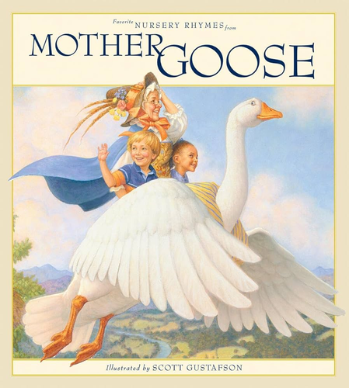
Main Characters
Think-Tank – Ruler of Mars, proud, arrogant, and overconfident.
Noodle – His apprentice, humble, polite, and actually intelligent.
Captain Omega – Leader of the Martian space crew.
Lieutenant Iota – Crew member who helps in reading the book.
Sergeant Oop – Strong soldier, often confused, adds humor.
The Book – A simple children’s book that confuses the Martians and ends up saving Earth

Slide 4
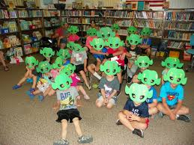
Setting Of The Play
Begins in the 25th century with a Historian as narrator.
She recalls events from the 20th century.
Scene shifts to Mars Central Control, where Think-Tank commands.
Later, the Martian crew visits an Earth library.
Mix of futuristic imagination (Mars, spaceships) and familiar places (library, books)

Slide 5
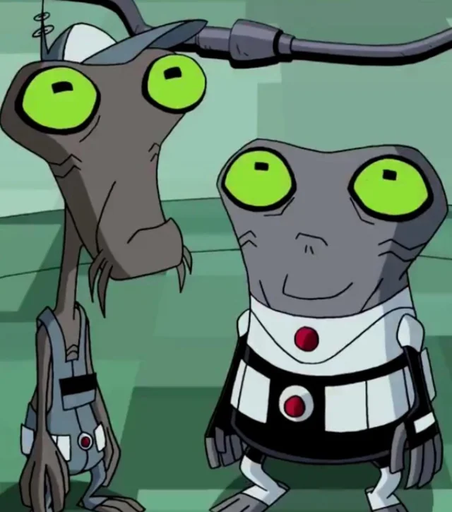
Plot Summary (Part 01)
Think-Tank, the ruler of Mars, plans to invade Earth.
He sends a crew: Omega, Iota, and Oop.
Crew lands in an Earth library full of books.
They find a strange object – a book.
Martians are confused, as they don’t know books.
Think-Tank’s guesses:
First says it is a sandwich (food).
Orders Oop to eat it, but the crew hesitates.
Thinks books might be communication devices.
Shows Think-Tank’s arrogance and foolishness.

Slide 6
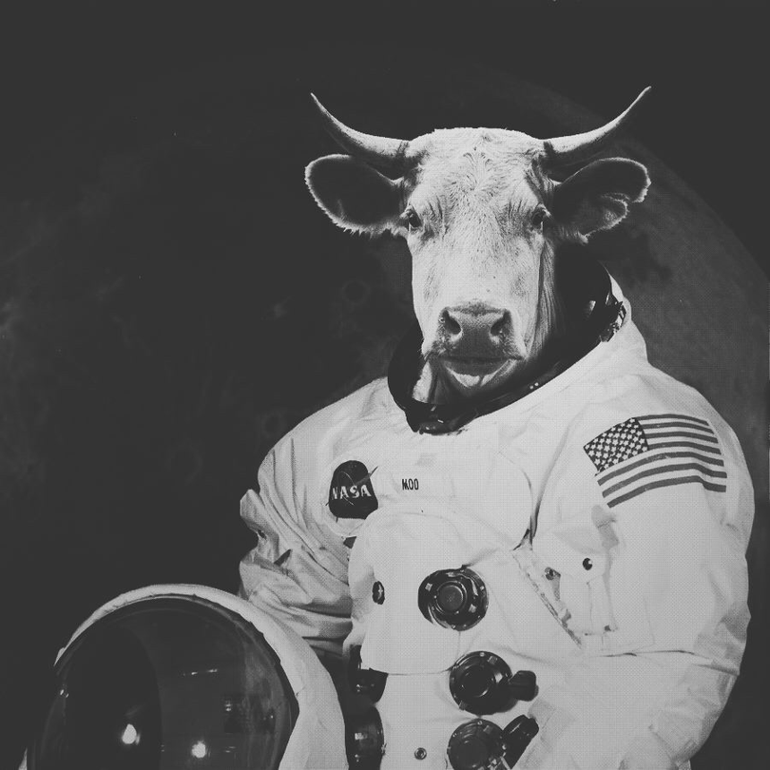
Plot Summary (Part 02)
Think-Tank changes his idea: book = communication device.
Crew tries to read nursery rhymes aloud.
“Hey Diddle Diddle” → Think-Tank imagines cows flying in space.
“Humpty Dumpty” → Think-Tank panics, compares it to his egg-shaped head.
Believes the book is a secret weapon manual.
Concludes Earth people are powerful and dangerous.
In fear, Think-Tank cancels the invasion.
Earth is saved by a simple children’s book.

Slide 7
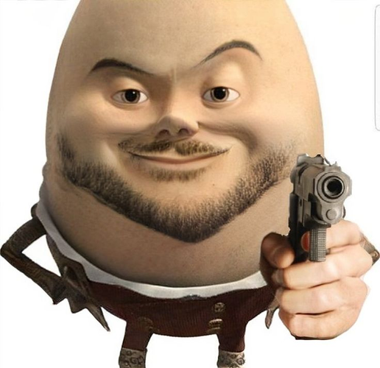
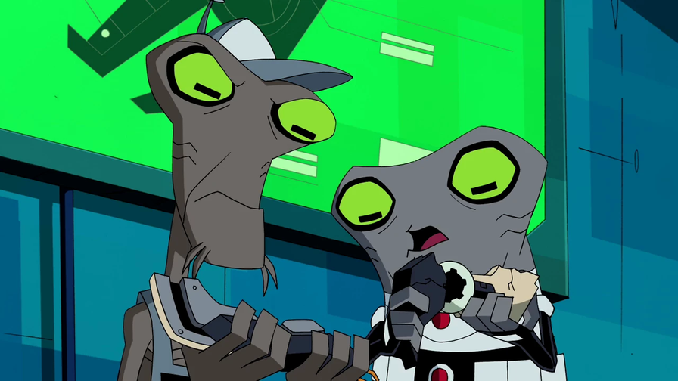
Humor In Play
Funny misinterpretations of nursery rhymes.
“Cow jumping over the moon” → Martians fear Earth has flying super cows.
“Humpty Dumpty” → Terrifies Think-Tank due to his egg-shaped head.
Think-Tank’s arrogance vs. Noodle’s quiet wisdom creates comic contrast.
Martians confuse books with sandwiches & weapons.
The irony: a simple children’s book defeats Martians.
Blends science fiction + comedy effectively.

Slide 8

Themes Of The Play
Power of Books – Knowledge in books can protect and guide humanity.
Knowledge vs. Arrogance – Noodle’s wisdom contrasts Think-Tank’s pride.
Imagination & Humor – Simple rhymes change the course of history.
Peace over War – Earth is saved not by weapons, but by literature.
Satire on Human Nature – Pride makes one foolish, while humility wins.

Slide 9


Message/Moral
Never underestimate the power of knowledge.
Books & ideas are more powerful than weapons.
Arrogance leads to foolish mistakes.
Humility + wisdom always win.
Imagination & literature shape our future.
True strength lies in learning, not force

Slide 10
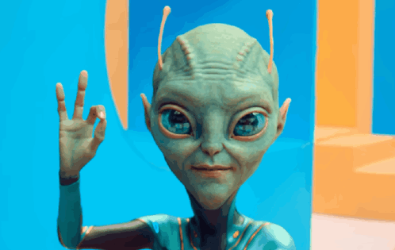
Conclusion
Not just science fiction, but a life lesson.
A nursery rhyme book saved Earth from Martians.
Proves that:
Books = treasures of wisdom.
Humility > pride.
Uses humor + imagination to teach values.
Final message: Knowledge saves humanity.

Slide 11

“Successfully the Earth has been saved”.

